Slide 1
REACT JS

Slide 2
The MERN stack is a popular set of technologies used for building modern web applications. Here are four key points about it:
MongoDB: A NoSQL database that stores data in flexible, JSON-like documents, making it ideal for handling large amounts of unstructured data. It's scalable and easy to manage, with high availability features.
Express.js: A lightweight web application framework for Node.js, which simplifies the development of server-side applications. It helps build APIs and handle routing efficiently.
React.js: A JavaScript library for building user interfaces, particularly single-page applications (SPAs). React allows developers to create reusable components and manage the state of the application efficiently.
Node.js: A runtime environment for executing JavaScript code on the server side. It uses an event-driven, non-blocking I/O model, making it highly efficient and suitable for real-time applications.

Slide 3
How React Works?
Component-Based: React is built around components, which are like small building blocks of the user interface (UI). Each component controls a part of the UI, and you can reuse components throughout your application.
JSX (JavaScript XML): React uses JSX, a syntax that looks like HTML, but is actually a mix of JavaScript and HTML. It makes it easier to write UI components and manage dynamic content by allowing you to embed JavaScript directly in the markup.
Virtual DOM: React creates a "virtual" version of the actual DOM (Document Object Model). When changes are made, React updates the virtual DOM first, then compares it with the real DOM and only updates the parts that have changed, making the app faster.
State and Props: React components can hold state, which is data that can change over time. Props are like parameters passed to components from their parent, allowing data to flow from one component to another. Together, they help manage dynamic and interactive UIs.

Slide 4
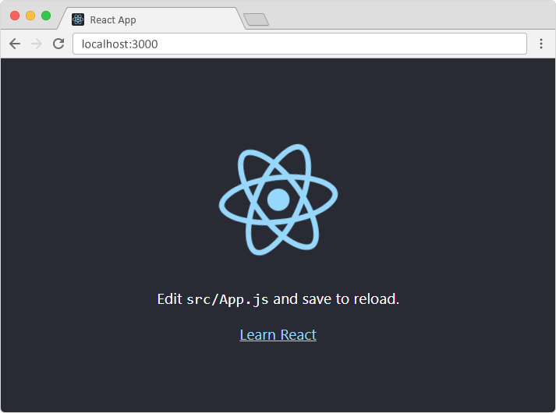
React Getting Started
Install Node.js and npm
node -v
npm -v
Create a New React Project (Use create-react-app)
npx create-react-app my-app
Navigate to Your Project Directory
cd my-app
Start the Development Server
npm start.

Slide 5
React Render HTML
The createRoot Function The createRoot() function takes one argument, an HTML element. The purpose of the function is to define the HTML element where a React component should be displayed.
The render Method The render() method is then called to define the React component that should be rendered.
But render where? There is another folder in the root directory of your React project, named "public". In this folder, there is an index.html file.
const container = document.getElementById('root');
const root = ReactDOM.createRoot(container);
root.render(<p>Hello</p>);
<body>
<div id="root"></div>
</body>

Slide 6
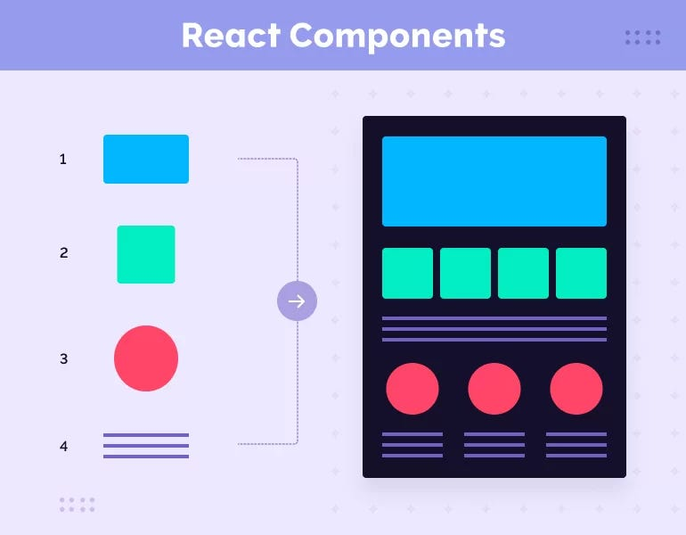
React Components
Components are independent and reusable bits of code.
They serve the same purpose as JavaScript functions, but work in isolation and return HTML.
Components come in two types:- Class components Function components

Slide 7
Class Component
A class component must include the extends React.Component statement.
This statement creates an inheritance to React.Component, and gives your component access to React.Component's functions.
The component also requires a render() method, this method returns HTML.
Function Component
A Function component also returns HTML, and behaves much the same way as a Class component, but Function components can be written using much less code
function Car() {
return <h2>Hi, I am a Car!</h2>;
}
class Car extends React.Component {
render() {
return <h2>Hi, I am a Car!</h2>;
}}

Slide 8
Component Constructor The Component Constructor is a special method used to initialize a new instance of a class component.
Initialization of State: The constructor is often used to initialize the state of a class-based component. The state is an object that holds data that can change over time and affect how the component renders.
Binding Methods: You can also use the constructor to bind event handler methods to the component instance. This is especially needed for methods that access this within the class component.
Super() Call: If you're defining a class component, the constructor must call super(props) to inherit the properties and behavior from React.Component. The props passed to the parent class (React.Component) are necessary to set up the component's props.
class Car extends React.Component {
constructor() {
super();
this.state = {color: "red"};
}
render() {
return <h2>I am a {this.state.color} Car!</h2>;
}
}

Slide 9
React Props(properties) A Way to pass data from a parent component to a child component in React.
Passing Data: Props are used to pass information (like strings, numbers, or even functions) from a parent component to a child component.
Read-Only: Props are immutable, meaning they cannot be changed by the child component. They are passed down from the parent, and the child can only read them.
Dynamic UI: By changing the values of props in the parent component, the child component will automatically re-render with the new data.
// Parent Component
function Parent() {
return (
<div>
<Child name="John" age={30} />
</div>
);
}
// Child Component
function Child(props) {
return (
<div>
<h1>Hello, my name is {props.name} and I am {props.age} years old.</h1>
</div>
);
}

Slide 10
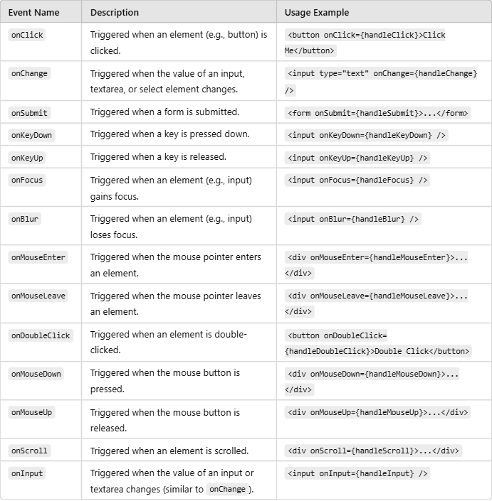
React Events Event Naming:
In React, event names are written in camelCase instead of lowercase. For example, onclick becomes onClick, onchange becomes onChange, etc.
Event Handler:
Event handlers are functions that are triggered when an event occurs. In React, you pass an event handler function as a prop to the element.
Event handler functions should be defined as functions (or as arrow functions), and you typically don't use parentheses when passing the function to the JSX element.
Synthetic Event:
React uses a SyntheticEvent wrapper around the native DOM events. This ensures that events work consistently across different browsers.
Binding the this Keyword:
If you're using class components, you may need to bind the event handler to the class instance, so it has access to this.

Slide 11
React Conditional Rendering

Slide 12
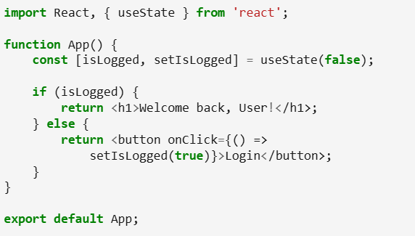
1.Using If/Else Statements

Slide 13
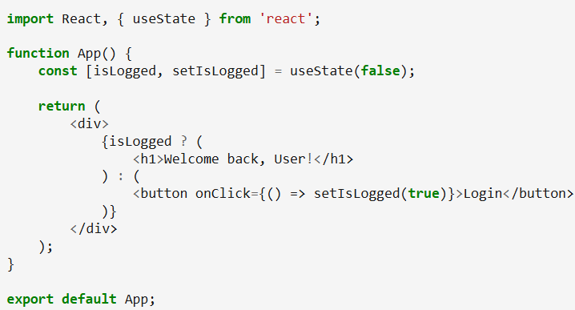
2.Ternary Operator

Slide 14
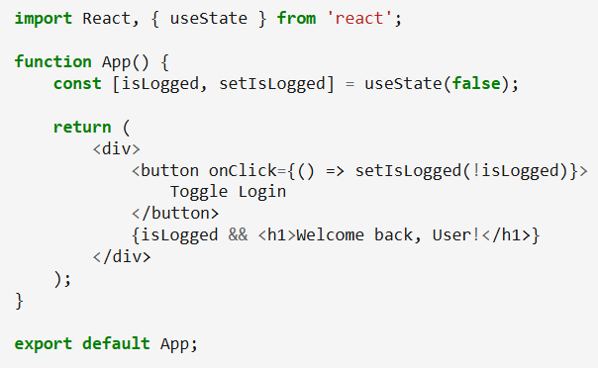
3. Using Logical AND (&&) Operator

Slide 15
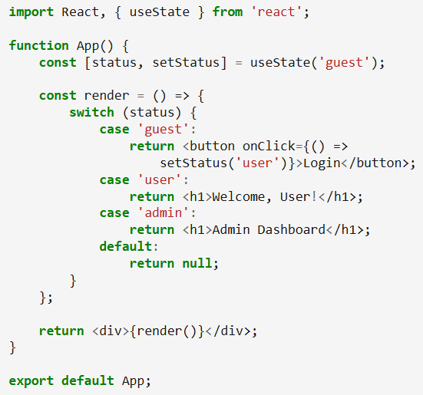
4. Using Switch Case Statements

Slide 16
React Router npm i -D react-router-dom
Route: A Route defines a path in the URL and the component that should be rendered for that path.
Link: A Link component is used to navigate between different routes (instead of using traditional anchor tags).
Switch: The Switch component ensures that only the first matching route is rendered, so you don’t get multiple components rendered for different routes.
BrowserRouter: A wrapper component that keeps track of the browser's URL and renders the correct route based on that URL.

Slide 17
//Router code
import React from 'react';
import { BrowserRouter as Router, Route, Switch, Link } from 'react-router-dom';
function App() {
return (
<Router>
<div>
{/* Navigation links */}
<nav>
<ul>
<li><Link to="/">Home</Link></li>
<li><Link to="/about">About</Link></li>
<li><Link to="/contact">Contact</Link></li>
</ul>
</nav>
{/* Routing paths */}
<Switch>
<Route path="/" exact component={Home} />
<Route path="/about" component={About} />
<Route path="/contact" component={Contact} />
</Switch>
</div>
</Router>
);
}
export default App;
import React from 'react';
import { BrowserRouter as Router, Route, Switch, Link } from 'react-router-dom';
function App() {
return (
<Router>
<div>
{/* Navigation links */}
<nav>
<ul>
<li><Link to="/">Home</Link></li>
<li><Link to="/about">About</Link></li>
<li><Link to="/contact">Contact</Link></li>
</ul>
</nav>
{/* Routing paths */}
<Switch>
<Route path="/" exact component={Home} />
<Route path="/about" component={About} />
<Route path="/contact" component={Contact} />
</Switch>
</div>
</Router>
);
}
export default App;

Slide 18
React Hooks Hooks were added to React in version 16.8.
Hooks allow function components to have access to state and other React features. Because of this, class components are generally no longer needed.
Although Hooks generally replace class components, there are no plans to remove classes from React.
Hooks allow us to "hook" into React features such as state and lifecycle methods.
There are 3 rules for hooks: Hooks can only be called inside React function components. Hooks can only be called at the top level of a component. Hooks cannot be conditional

Slide 19
useState HOOK
Purpose: Allows you to add state to a function component.
Usage: You use useState to declare a state variable and a function to update it.
import React, { useState } from 'react';
function Counter() {
const [count, setCount] = useState(0); // Declare state
return (
<div>
<p>You clicked {count} times</p>
<button onClick={() => setCount(count + 1)}>Click me</button>
</div>
);
}

Slide 20
useEffect HOOK
Purpose: Allows you to perform side effects in function components (e.g., fetching data, DOM manipulations, or setting up subscriptions).
Usage: It runs after every render or when specific state/props change useEffect accepts two arguments. The second argument is optional.useEffect(<function>, <dependency>)
import React, { useState, useEffect } from 'react';
function Timer() {
const [seconds, setSeconds] = useState(0);
useEffect(() => {
const interval = setInterval(() => {
setSeconds(prevSeconds => prevSeconds + 1);
}, 1000);
return () => clearInterval(interval); // Cleanup on unmount
}, []); // Empty dependency array means it runs only once (like componentDidMount)
return <p>Time elapsed: {seconds} seconds</p>;
}

Slide 21
useContext HOOK
Purpose: Allows you to access the value of a Context directly in a function component.
Usage: It is used to access data from a React Context without needing to wrap components in a Consumer or use the Context.Consumer component.
import React, { useContext } from 'react';
const MyContext = React.createContext('Default Value');
function Display() {
const value = useContext(MyContext); // Get context value
return <p>Context Value: {value}</p>;
}
function App() {
return (
<MyContext.Provider value="Hello, World!">
<Display />
</MyContext.Provider>
);
}

Slide 22
import React, { useReducer } from 'react';
// Reducer function
const initialState = { count: 0 };
function reducer(state, action) {
switch (action.type) {
case 'increment':
return { count: state.count + 1 };
case 'decrement':
return { count: state.count - 1 };
default:
return state;
}
}
function Counter() {
const [state, dispatch] = useReducer(reducer, initialState);
return (
<div>
<p>Count: {state.count}</p>
<button onClick={() => dispatch({ type: 'increment' })}>Increment</button>
<button onClick={() => dispatch({ type: 'decrement' })}>Decrement</button>
</div>
);
}
useReducer HOOK
Purpose: Used to manage more complex state logic in function components (similar to how Redux manages state).
Usage: Works like useState, but instead of updating the state directly, you dispatch actions to update the state.

Slide 23
useRef HOOK
Purpose: Allows you to persist values across renders without causing a re-render, and it can also be used to directly access a DOM element.
Usage: Used for accessing DOM elements or storing values that don't trigger a re-render when updated.
import React, { useRef } from 'react';
function FocusInput() {
const inputRef = useRef(null);
const handleFocus = () => {
inputRef.current.focus();
};
return (
<div>
<input ref={inputRef} type="text" />
<button onClick={handleFocus}>Focus the input</button>
</div>
);
}

Slide 24
import React, { useState, useMemo } from 'react';
function ExpensiveCalculation({ num }) {
const expensiveResult = useMemo(() => {
return num * num; // Expensive calculation
}, [num]); // Re-run only when 'num' changes
return <p>Calculated result: {expensiveResult}</p>;
}
function App() {
const [num, setNum] = useState(1);
return (
<div>
<button onClick={() => setNum(num + 1)}>Increase</button>
<ExpensiveCalculation num={num} />
</div>
);
}
useMemo HOOK
Purpose: Memoizes the result of an expensive computation so it doesn’t have to be recalculated on every render.
Usage: It is useful for optimization, particularly when dealing with performance bottlenecks.

Slide 25
import React, { useState, useCallback } from 'react';
function Child({ onClick }) {
console.log('Child re-rendered');
return <button onClick={onClick}>Click me</button>;
}
function Parent() {
const [count, setCount] = useState(0);
// Memoizing the callback to prevent unnecessary re-renders
const memoizedCallback = useCallback(() => {
setCount(count + 1);
}, [count]);
return (
<div>
<p>Count: {count}</p>
<Child onClick={memoizedCallback} />
</div>
);
}
useCallback HOOK
Purpose: Returns a memoized version of a function that only changes if one of its dependencies has changed.
Usage: Useful for preventing unnecessary re-renders when passing callbacks to child components.

Slide 26
import React from 'react';
import useInput from './useInput'; // Import the custom hook
function Form() {
// Using the custom hook for two input fields
const name = useInput('');
const email = useInput('');
const handleSubmit = (e) => {
e.preventDefault();
alert(`Name: ${name.value}, Email: ${email.value}`);
};
return (
<form onSubmit={handleSubmit}>
<div>
<label>Name:</label>
<input type="text" {...name} />
</div>
<div>
<label>Email:</label>
<input type="email" {...email} />
</div>
<button type="submit">Submit</button>
</form>
);
}
export default Form;
React Custom Hooks
It uses one or more built-in hooks (like useState, useEffect, etc.).
It returns values or functions that can be used by components.
Code Reusability: Share stateful logic between components without repeating code.
Abstraction: Encapsulate complex logic into a simpler and reusable function.
Cleaner Code: Avoid code duplication and keep components more focused on rendering.

Slide 27
Thank You

